Slide 1

Modern Web 3.0 Blockchain App
BY – SUDIPTA NARAYAN DHAR
SUBHAM BHATTACHARYYA
MD RISHER ALI
ANIMESH PRASADI
SWARNAVA HALDER
SOURAV SARKAR
PROJECT GUIDE –
PROF. SUKANYA ROY
PROF. PRASENJIT KUMAR DAS

Slide 2

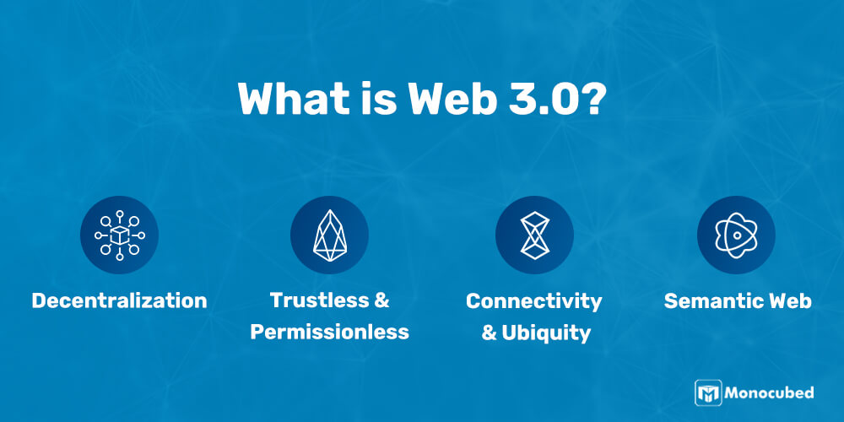
What Is Web 3.0?
Web 3.0 (also known as web3) is the third iteration of the Internet that interconnects data in a decentralized way to deliver a faster and more personalized user experience. It is built using artificial intelligence, machine learning and the semantic web, and uses the blockchain security system to keep your information safe and secure.

Slide 3
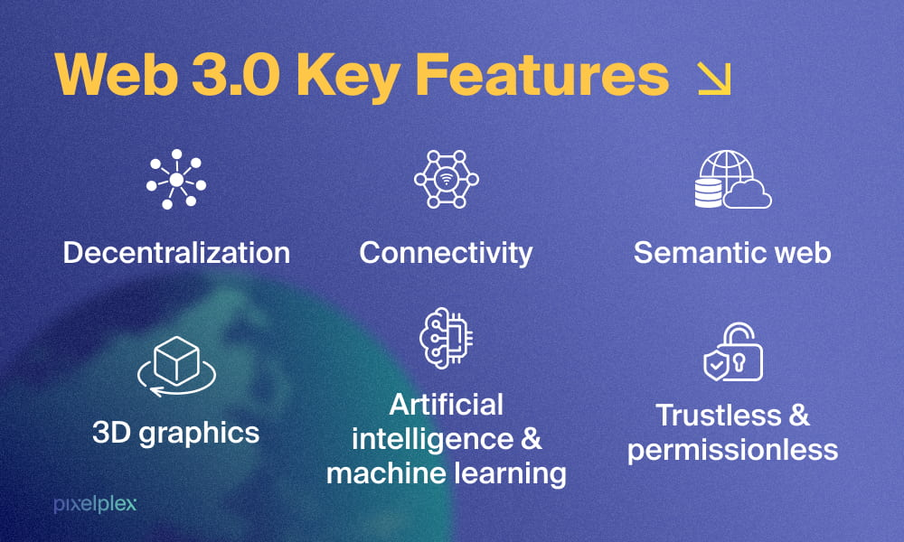

Slide 4
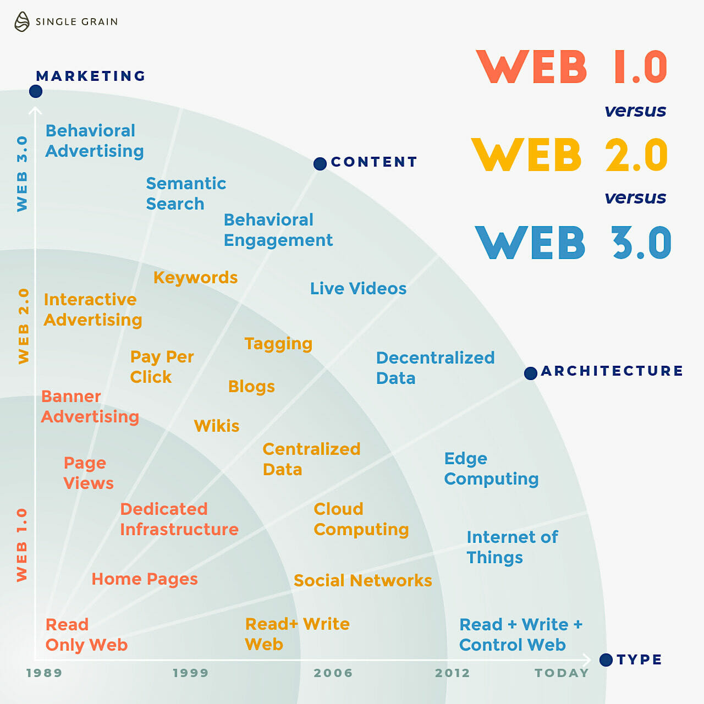
Difference Between Web 1.0, Web 2.0 and Web 3.0
Web 1.0 is a read-only web where
people can read information
written on websites.
Web 2.0 is a read-write web
where people can read and write
content on websites and
applications.
Web 3.0 is a read-write-interact web
(powered by artificial intelligence)
where people can read, write and
interact with content, including
3D graphics, on websites and apps.

Slide 5
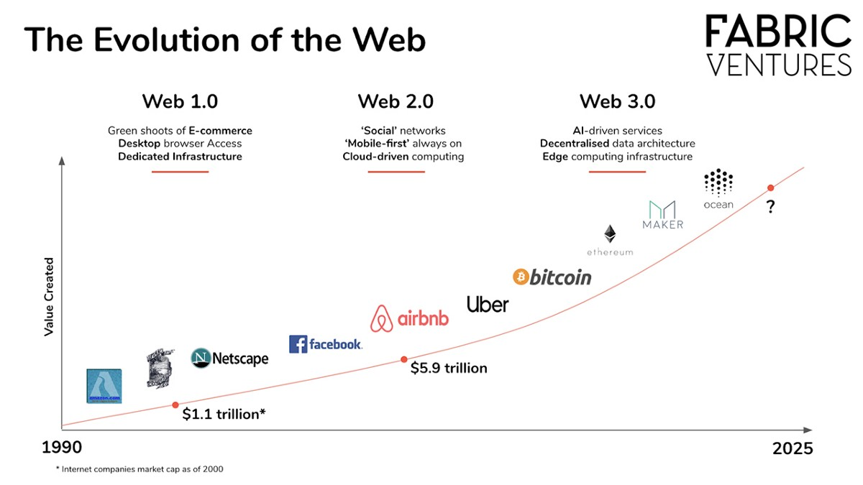

Slide 6
Layers of Web 3.0
Edge Computing: Data centers are complemented by an array of advanced computing resources distributed among phones, laptops, appliances, sensors and cars, which will produce and consume 160 times more data in 2025 than in 2010.
Decentralized Data Network: Decentralized data networks enable various data generators to sell or trade their data without losing ownership, risking privacy or relying on intermediaries. As a result, decentralized data networks will have a long list of data providers in the growing ‘data economy.‘
Artificial Intelligence & Machine Learning: Artificial intelligence and machine learning algorithms have advanced to make valuable, and sometimes life-saving, predictions and acts. When built on top of emerging decentralized data structures that provide access to a plethora of data that today's tech titans desire, the possible applications extend far beyond targeted advertising.
Blockchain: Blockchain is a decentralized state machine that deploys intelligent contracts. These smart contracts define the logic of an application for web 3.0. So anyone who wishes to build a blockchain application needs to deploy their application code on the shared state machine.

Slide 7
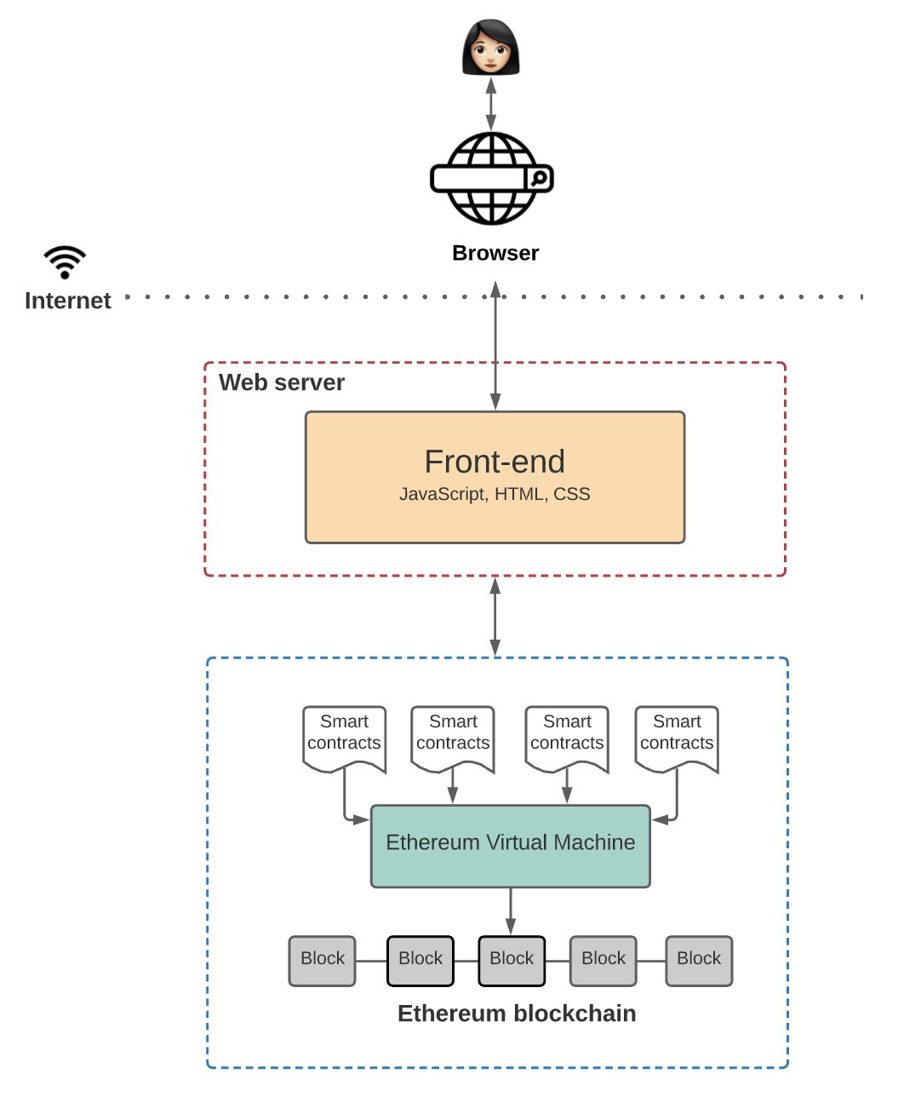
How Does Web 3.0 Work?

Slide 8
Web 3.0 Architecture
There are primarily four elements in the architecture that make up web 3.0:
1) Ethereum Blockchain – These are globally accessible state machines maintained by a
peer-to-peer network of nodes. Anyone in the world can access the state machine and
write to it. Essentially, it is not owned by any single entity but, rather, collectively by
everyone in the network. Users can write to the Ethereum Blockchain, but they can
never update existing data.
2) Smart Contracts – These are programs run on the Ethereum Blockchain. These are written by
the app developers in high-level languages, such as Solidity or Vyper, to define the logic
behind the state changes.
3) Ethereum Virtual Machine (EVM) – The purpose of these machines is to execute the logic
defined in the smart contracts. They process the state changes taking place on the state
machine.
4) Front End – Like any other application, the front-end defines the UI logic. However, it also
connects with smart contracts that define application logic.

Slide 9
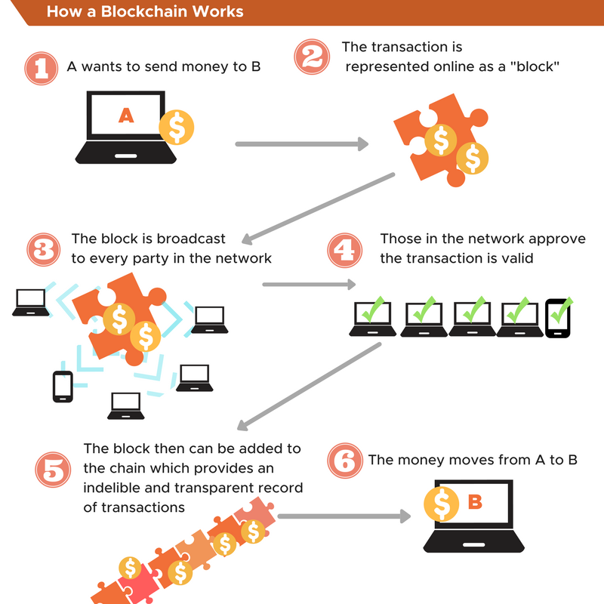
WHAT IS BLOCKCHAIN?
Blockchain is the technology (along with
others like IoT and AI) behind web
3.0. More specifically, blockchain is the
foundation of web3, as it redefines
the data structures in the backend of
the semantic web.
Blockchain, also called Ethereum blockchain,
is a decentralized state machine that
deploys intelligent contracts. These smart
contracts define the logic of an application
for web 3.0. So anyone who wishes to build
a blockchain application needs to deploy
their application code on the shared
state machine.

Slide 10
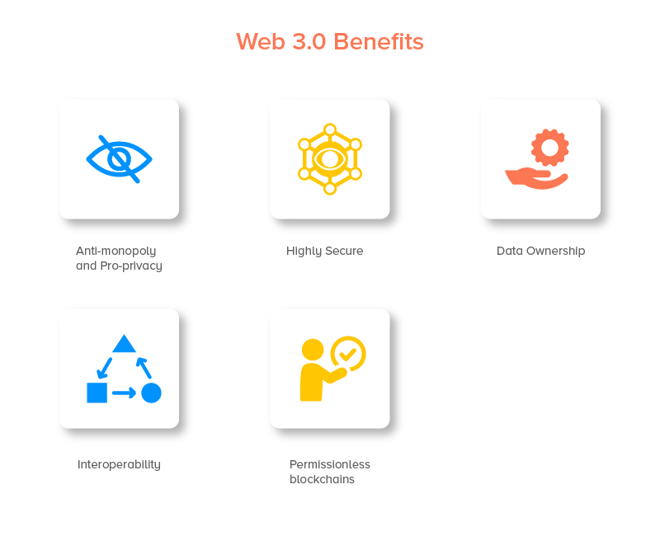
Advantages of Web 3.0
Data Privacy and Control
Seamless Services
Transparency
Open Accessibility to Data
Restrictionless Platform
Single Profile Creation
Enhanced Data Processing

Slide 11
Disadvantages of Web 3.0
Requires Advanced Devices
Web 1.0 Websites Will Become Obsolete
Not Ready for Widespread Adoption
Demand for Reputation Management Will Increase
Complicated Functionality

Slide 12
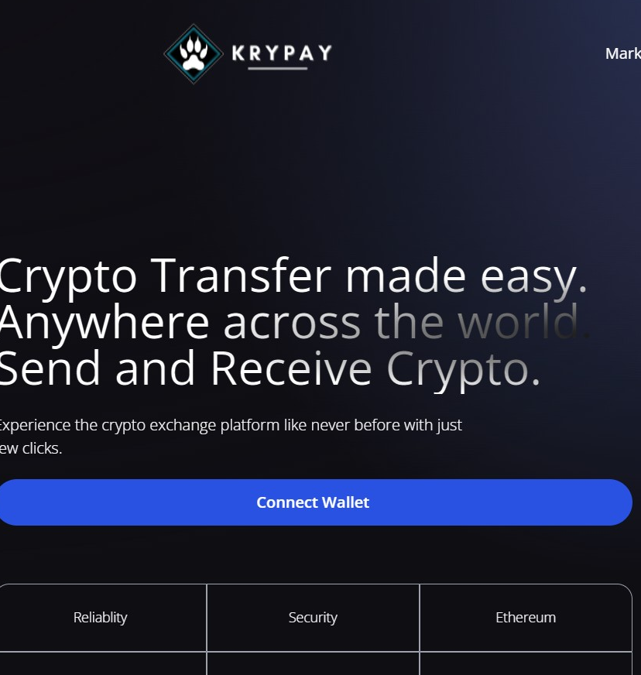
PROJECT KRYPAY

Slide 13
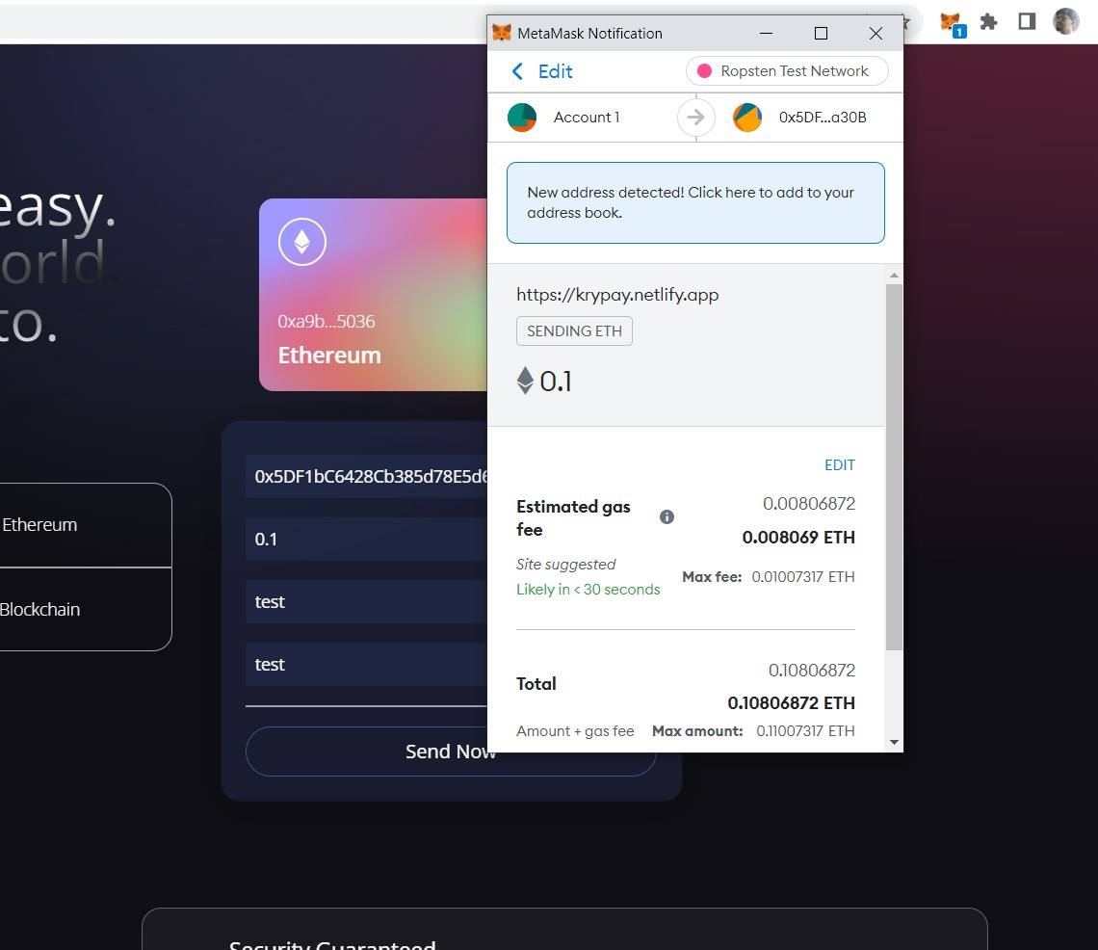
KRYPAY
KryPay is a Web3 based blockchain website using solidity,react.js and tailwind css. It is used for transaction of ethereum connected with your metamask wallet.

Slide 14


